Slide 1
IMAGE BASED ATTENDANCE MONITORING SYSTEM
Group Number : 23
1.Dhanush M Kuber 1PE12EC041
2.Chethan Kumar TJ 1PE13EC031
3.Bhagyashree 1PE13EC024
4.Mridula C 1PE13EC076
Guide: Dr. Subhash S Kulkarni

Slide 2
OBJECTIVE
For a given group photo detect and isolate individual faces and subject it to recognition and mark the attendance accordingly .

Slide 3




DESIGN FLOW WITH TIMELINE
Data base building
Literature collection
Pre processing
15/10/16
Face detection
15/12/16
Feature set
Building and
Recognition
1/2/17
Demonstration
And compilation
25/4/17
Android enabled
App building
15/4/17
Integration
and Testing
15/3/17

Slide 4
TASKS PERFORMED TO DATE
Image Detection and Recognition using MATLAB
Detection - Viola and Jones Algorithm
Recognition - Eigen Face using Principle Component
Analysis
Integration of Detection and Recognition modules (MATLAB)

Slide 5
ALGORITHM
DETECTION - Performed using Viola and Jones Algorithm
RECOGNITION - Using Principle component analysis (PCA) and Eigen Faces

Slide 6
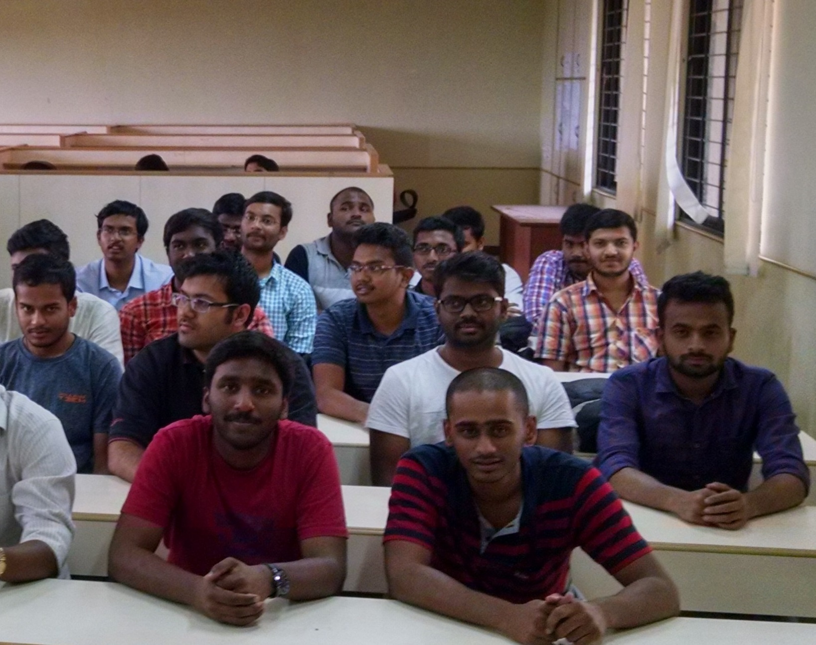
RESULTS
Input Image

Slide 7
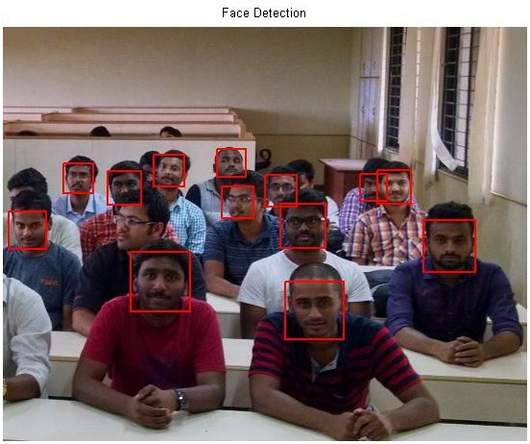
After Detection

Slide 8
Database
Group of 15 subjects
Various angles
5 images of every subject with varying face orientation
Under similar conditions

Slide 9
Forthcoming
Increase the recognition Accuracy
Extend the recognition on a database from 15 till 30 people.

Slide 10
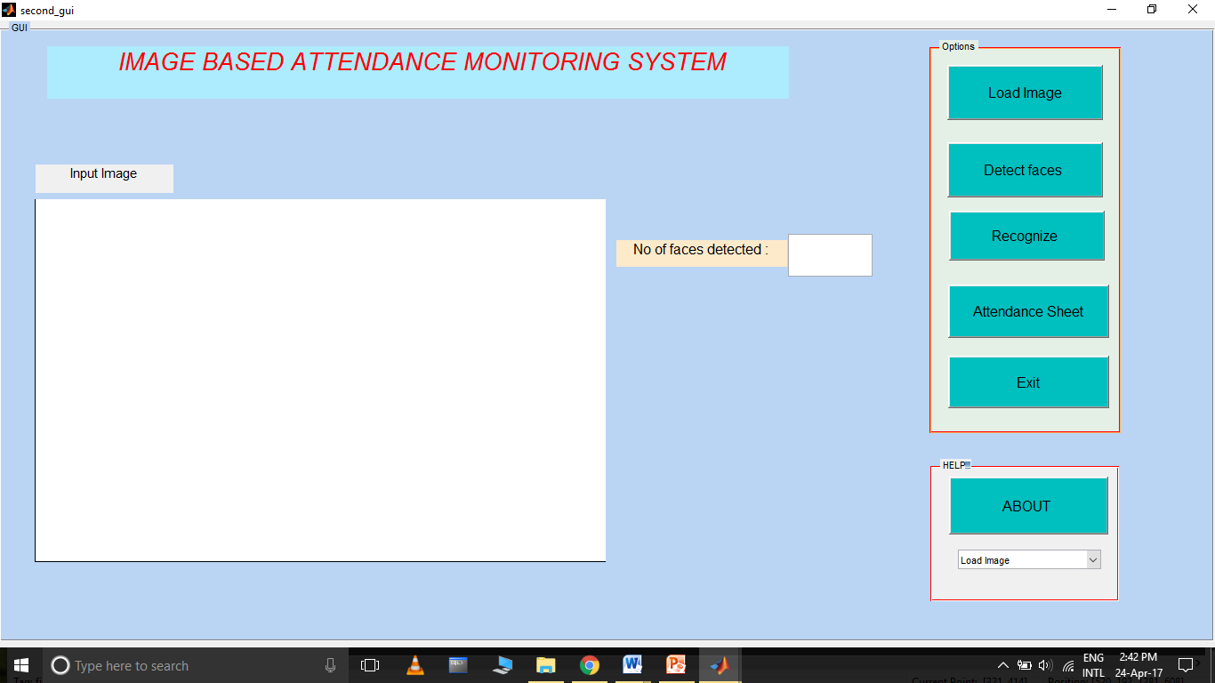
GRAPHICAL USER INTERFACE

Slide 11
REFERENCES
1) Face and Eye Detection Using OpenCV: Step by Step Mahdi Rezaei Department of Computer Science, the University of Auckland
2) Robust real time object detection,IJCV 2001: Viola,Jones
3)Eigenface-based facial recognition 2002, Dimitri PISSARENKO

